Slide 1

CSCE 121 Introduction to Program Design & Concepts
The string class and data representation
Dr. Tim McGuire
Grateful acknowledgment to Dr. Philip Ritchey and Dr. Michael Moore for some of the material on which these slides are based.

Slide 2
The C++ string Class
Notes:
Start here for 3:10 class

Slide 3
The C++ string Class
Special data type supports working with strings
#include <string>
Can define string variables in programs:
string firstName, lastName;
Can receive values with assignment operator:
firstName = "Rock";
lastName = "GoodAg";
Can be displayed via cout
cout << firstName << " " << lastName;

Slide 4
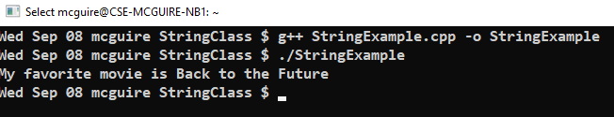
The string class in a Program
// This program demonstrates the string class.
#include <iostream>
#include <string> // Required for the string class.
using std::cout;
int main()
{
string movieTitle;
movieTitle = “Back to the Future";
cout << "My favorite movie is " << movieTitle << endl;
return 0;
}
Program Output:

Slide 5
Working with string Objects
Using cin with the >> operator to input strings can cause problems:
It passes over and ignores any leading whitespace characters (spaces, tabs, or line breaks)
To work around this problem, you can use a C++ function named getline.

Slide 6
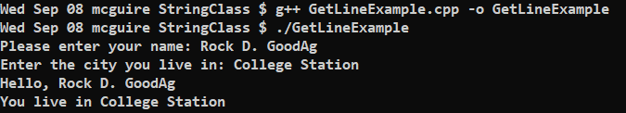
Using getline in a program
// This program demonstrates using the getline function
// to read character data into a string object.
#include <iostream>
#include <string>
using namespace std;
int main()
{
string name;
string city;
cout << "Please enter your name: ";
getline(cin, name);
cout << "Enter the city you live in: ";
getline(cin, city);
cout << "Hello, " << name << endl;
cout << "You live in " << city << endl;
return 0;
}
GetLineExample.cpp

Slide 7
Working with Characters and string Objects
Mixing cin >> and getline() can be tricky, because cin >> leaves the newline in the input, while getline() does not skip leading whitespace.
To skip over unneeded characters that are still in the keyboard buffer, use cin.ignore():
cin.ignore(); // skip next char
cin.ignore(10, '\n'); // skip the next 10 char. or until a '\n'

Slide 8
string Member Functions and Operators
To find the length of a string:
To concatenate (join) multiple strings:
string state = "Texas";
int size = state.length();
greeting2 = greeting1 + name1;
greeting1 = greeting1 + name2;
Or using the += combined assignment operator:
greeting1 += name2;

Slide 9
Comparing string Objects
Strings are compared using their ASCII values
string name1 = "Mary";
string name2 = "Mark";
The characters in each string must match before they are equal
name1 > name2 // true
name1 <= name2 // false
name1 != name2 // true
name1 < "Mary Jane" // true

Slide 10
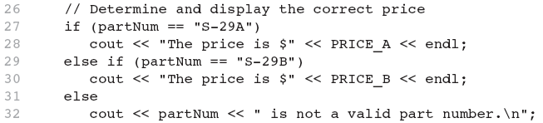
Relational Operators Compare Strings
See StringCompare.cpp for full working code

Slide 11
string Operators
OPERATOR | MEANING
>> | extracts characters from stream up to whitespace, insert into string
<< | inserts string into stream
= | assigns string on right to string object on left
+= | appends string on right to end of contents on left
+ | concatenates two strings
[] | references character in string using array notation (It is safer to use the at() method, however)
>, >=, <, <=, ==, != | relational operators for string comparison. Return true or false

Slide 12
string Operators Example
string word1, phrase;
string word2 = " Dog";
cin >> word1; // user enters "Hot Tamale"
// word1 has "Hot"
phrase = word1 + word2; // phrase has "Hot Dog"
phrase += " on a bun";
for (int i = 0; i < phrase.length(); i++)
cout << phrase.at(i); // displays "Hot Dog on a bun"

Slide 13
string Member Functions
Categories:
assignment: assign, copy, data
modification: append, clear, erase, insert, replace, swap
space management: capacity, empty, length, resize, size
substrings: find, substr
comparison: compare
And several more

Slide 14
Member Function length
The string class member function length returns the number of characters in the string object:
Example: int n = stringVar.length( );

Slide 15
Member Function at
at is an alternative to using [ ]'s to access characters in a string.
at checks for valid index values
Example: string str("Mary Jane"); cout << str[6] << endl; cout << str.at(6) << endl; str[2] = 'X'; str.at(2) = 'X';
Equivalent
Equivalent

Slide 16
string class to numbers
C++ has functions to convert a string class object to a number
int i; double d; string s; i = stoi("35"); // Converts the string "35" to an integer 35 d = stod("2.5"); // Converts the string "2.5" to the double 2.5
C++ has functions to convert a number to a string class object string s = to_string(1.2*2); // “2.4” stored in s

Slide 17
Finding in a string
find() | find(item) returns index of first item occurrence, else returns string::npos (a constant defined in the string library). Item may be char, string variable, string literal (or char array). find(item, indx) starts at index indx.
Notes:
Start here for 4:10 and 5:45 classes

Slide 18
Finding in a string
find() | find(item) returns index of first item occurrence, else returns string::npos (a constant defined in the string library). Item may be char, string variable, string literal (or char array). find(item, indx) starts at index indx.
// userText is "Help me!" userText.find('p') // Returns 3 userText.find('e') // Returns 1 (first occurrence of e only)
userText.find('z') // Returns string::npos userText.find("me") // Returns 5 userText.find('e', 2) // Returns 6 (starts at index 2)

Slide 19
Getting a substring
substr() | substr(index, length) returns substring starting at index and having length characters.

Slide 20
Getting a substring
substr() | substr(index, length) returns substring starting at index and having length characters.
// userText is "http://google.com" userText.substr(0, 7) // Returns "http://" userText.substr(13, 4) // Returns ".com" userText.substr(userText.size() - 4, 4) // Last 4: ".com"

Slide 21
Numeric Data Types

Slide 22
Positional Number Systems
Decimal (base 10) is an example
e.g.,
435 means
400 + 30 + 5
4 x 10² + 3 x 10¹ + 5 x 10⁰
Example of a non-positional system: Roman numerals
inconvenient for humans
unusable for computers
This concept applies to other bases as well
©1999-2021 by Timothy J. McGuire, Ph.D.
22
Notes:
22

Slide 23
Binary & Decimal Numbers
Base 2 -- natural for computers
0 represents OFF, 1 represents ON
Base 10 -- natural for humans
decimal system uses 10 symbols, 0 - 9
binary system uses 2 symbols, 0 & 1
0, 1, 10, 11, 100, 101, 110, 111, 1000, 1001, etc.
1101₂ may be written as
1x2³ + 1x2² + 0x2¹ + 1x2⁰ = 8 + 4 + 0 + 1 = 13₁₀
©1999-2017 by Timothy J. McGuire, Ph.D.
23

Slide 24
Everything is Bits
In memory everything is a 1 or a 0.
Datatype indicates how those bits are interpreted.

Slide 25
01000011 00101101 00110111 00000000
32 bit binary
Integer (2’s Complement): 1127036672
Unsigned Integer: 1127036672
Float: 173.21484375
Characters (ASCII): C-7

Slide 26
11000001 00111100 01100101 00000000
32 bit binary
Integer (2’s Complement): -1053006592
Unsigned Integer: 3241960704
Float: -11.774658203125
Characters (ASCII): Á<e
For signed numbers, the leftmost bit indicates the sign
1: negative
0: positive

Slide 27
Integers
Raw numbers
Different size variables
C++ datatypes
char
short
int
long
Number of bytes depends on system and compiler
Signed numbers frequently (but not always) represented with 2’s complement.
Notes:
Start here for 3:00 class 9/16

Slide 28
Binary Numbers
Base Ten Numbers (Integers)
digits: 0 1 2 3 4 5 6 7 8 9
5401 is 5x10³ + 4x10² + 0x10¹ + 1x10⁰
Binary numbers are the same
digits: 0 1
1011 is 1x2³ + 0x2² + 1x2¹ + 1x2⁰

Slide 29
Other common number representations
Octal Numbers
digits: 0 1 2 3 4 5 6 7
7120 is 7x8³ + 1x8² + 2x8¹ + 0x8⁰
3664 (base 10)
Hexadecimal Numbers
digits: 0 1 2 3 4 5 6 7 8 9 A B C D E F
2FD6 is 2x16³ + Fx16² + Dx16¹ + 6x16⁰
12,246 (base 10)
http://www.kaagaard.dk/service/convert.htm

Slide 30
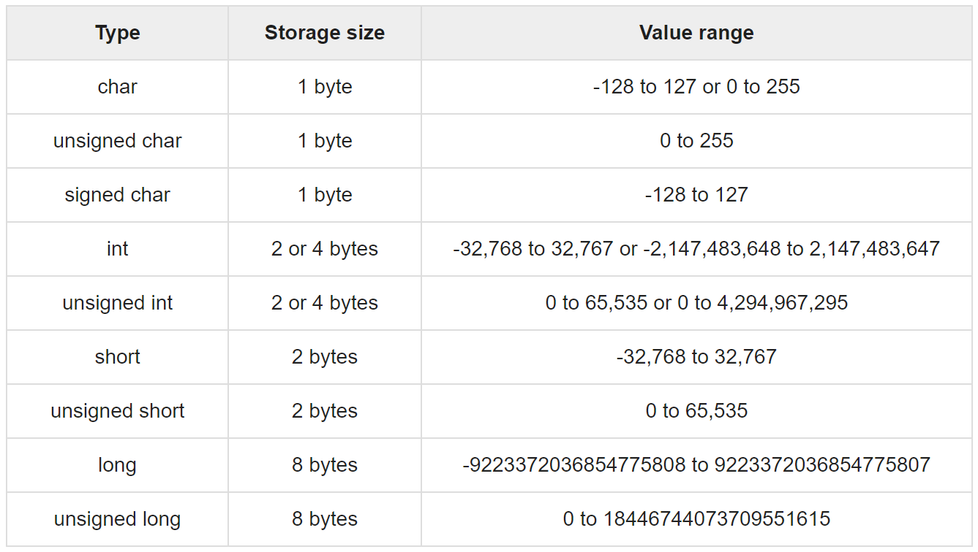
https://www.tutorialspoint.com/cprogramming/c_data_types.htm

Slide 31
Character Representation
Not all data are treated as numbers
However they must be coded as binary numbers in order to be processed
ASCII (American Standard Code for Information Interchange) is the standard encoding scheme used to represent characters in binary format on personal computers
©1999-2017 by Timothy J. McGuire, Ph.D.
31

Slide 32
Characters
Char
Actually a numeric datatype
Output converts number to corresponding output character (lookup)
Only 256 options
http://www.rapidtables.com/code/text/ascii-table.htm
Unicode (we won’t use but good to know it exists)
http://www.utf8-chartable.de/unicode-utf8-table.pl?number=1024&utf8=bin
C++ 11 supports
wchar_t (wide character)
char16_t
char32_t

Slide 33
Floating Point Numbers
Decimal Numbers
3 parts
Sign
Exponent
Mantissa

Slide 34
Floating Point
Representation for non-integral numbers
Including very small and very large numbers
Like scientific notation
–2.34 × 10⁵⁶
+0.002 × 10^{–4}
+987.02 × 10⁹
In binary
±1.xxxxxxx₂ × 2^{yyyy}
Types float and double in C++
normalized
not normalized

Slide 35
Floating Point Standard
Defined by IEEE Std 754-1985
Developed in response to divergence of representations
Portability issues for scientific code
Now almost universally adopted
Two representations
Single precision (32-bit)
Double precision (64-bit)

Slide 36
IEEE Floating-Point Format
single: 8 bits double: 11 bits
single: 23 bits double: 52 bits
S
Exponent
Fraction
S: sign bit (0 ⇒ non-negative, 1 ⇒ negative)
Normalize significand: 1.0 ≤ |significand| < 2.0
Always has a leading pre-binary-point 1 bit, so no need to represent it explicitly (hidden bit)
Significand is Fraction with the “1.” restored
Exponent: excess representation: actual exponent + Bias
Ensures exponent is unsigned
Single: Bias = 127; Double: Bias = 1203

Slide 37
Floating-Point Example
Important: Integer arithmetic is always exact (unless there is overflow)
Floating point arithmetic is usually not. You cannot represent the base 10 fraction 0.1 exactly in binary – it becomes an infinitely repeating binary fraction.
Represent –0.75
–0.75 = (–1)¹ × 1.1₂ × 2^{–1}
S = 1
Fraction = 1000…00₂
Exponent = –1 + Bias
Single: –1 + 127 = 126 = 01111110₂
Double: –1 + 1023 = 1022 = 01111111110₂
Single: 1011111101000…00
Double: 1011111111101000…00
See FloatingPoint.cpp

